Slide 1
CoverUp: Privacy Through
“Forced” Participation in
Anonymous Communication Networks
David Sommer, Aritra Dhar, Luka Malisa
Esfandiar Mohammadi, Daniel Ronzani, Srdjan Capkun

Slide 2



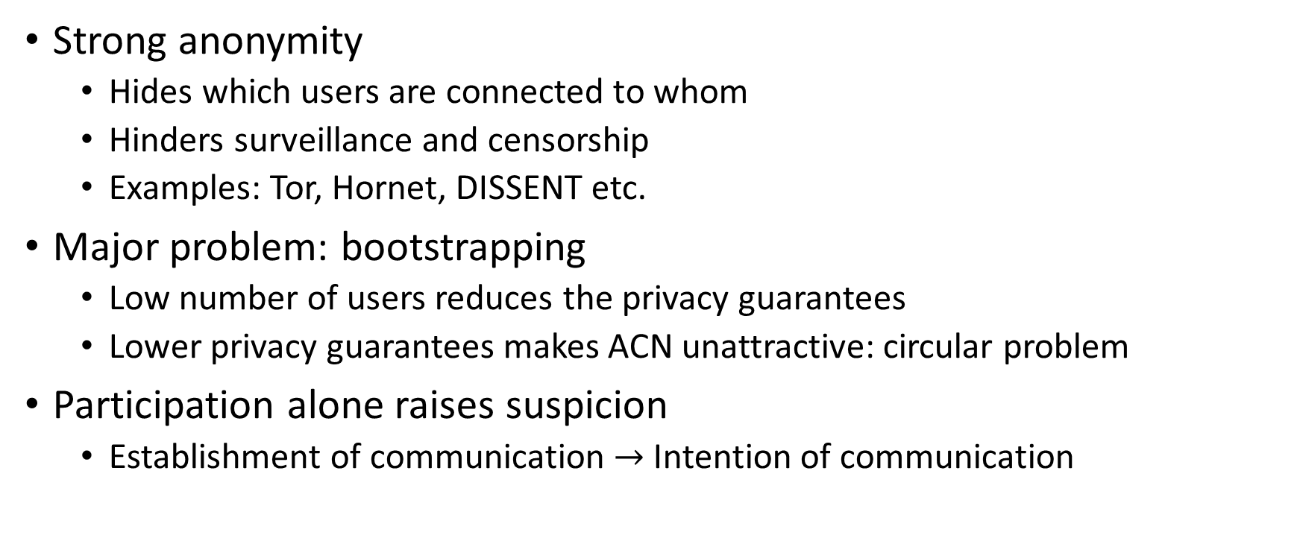
Motivations: ACN
Strong anonymity
  Hides which users are connected to whom
  Hinders surveillance and censorship
  Examples: Tor, Hornet, DISSENT etc.
Major problem: bootstrapping
  Low number of users reduces the privacy guarantees
  Lower privacy guarantees makes ACN unattractive: circular problem
Participation alone raises suspicion
  Establishment of communication $→$ Intention of communication
Notes:
Strong attacker model : can see everything

Slide 3




Motivations: Deniability
Intention hiding more than deniability
  Accessing classified or leaked documents
  Information related to specific medic conditions
Covert Channels & steganography
  Covertcast, FreeWave, SWEET etc.
  Only partial solution
Why is it important?
  Freedom of speech
  Whistleblowers
  Open journalism
  User profiling by governmental agencies
Notes:
Intention hiding: Deniability is not enough for ...
Medic conditions like HIV, or even about socially critical living “choices”.

Slide 4




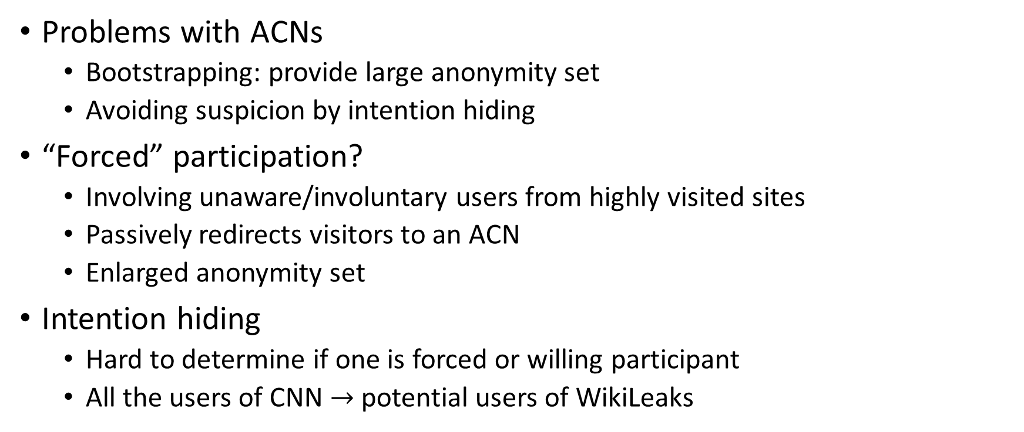
Forced Participation?
Problems with ACNs
  Bootstrapping: provide large anonymity set
  Avoiding suspicion by intention hiding
“Forced” participation?
  Involving unaware/involuntary users from highly visited sites
  Passively redirects visitors to an ACN
  Enlarged anonymity set
Intention hiding
  Hard to determine if one is forced or willing participant
  All the users of CNN $→$ potential users of WikiLeaks
Notes:
Solved Deniability issue.
The animation: introduce voluntary and involuntary participant terms here

Slide 5
Contributions
Uses “forced participation”
  Unidirectional channel to deliver broadcast (Feed)
  Bidirectional channel to implement secure chat protocol
Previous Work
  ConScript, AdLeaks, New covert channels in HTTP
Working Prototype
Detailed attacker model
  Analysis of the attacker’s capabilities
  Analysis of privacy leakage and mitigation techniques
Quantitative privacy metric
Notes:
In contrast to previous work we implemented fully functional uni and bidirectional channel. Broadcast feed and a bidirectional chat.
Privacy metric: privacy budget-> time in which the voluntary participants can hide in the cover traffic provided by the involunta1ry participants

Slide 6

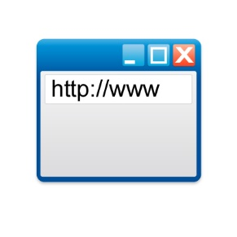


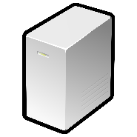


voluntary participants
involuntary participants
CoverUp
1. connects to
browser
5. extract
feed content
entry server
2. forces clients
to connect to
external application
.
.
.
Attacker model
  Full network control (monitor/drop/fake)
  Entry and CoverUp server
  mix server (unidirectional only)
Trust assumption
  Voluntary user’s machine not compromised
CoverUp server
3. forwards
via JS code to
4. sends
feed to
mix server
Notes:
2. FORES BY IFRAME.
At feed: mention this is unidirectional case! mention cache
Mention indistinguishability. Because all do the same.
Active attacker cannot do anything!
Coverup serer cannt be malicous in bi-directional case b/c same origin policy is needed to protect CoverUp JS
Feed consists out of more than one packet.

Slide 7




Unidirectional channel: Feed
involuntary participants
voluntary participant
www
local
storage
+
+
JavaScript
=
Mix
server
Browser
External Application
Notes:
Predefined list of documents -> random delivery -> no choice (would reveal intention)
Fountain code (error correction code, order does not matter, one collects these pieces until one has enough to assemble end data)
All or nothing encryption scheme: Set to protect people, no dangerouse content on involuntary users machines

Slide 8
Bi-directional channel: Chat
Enhances feed
  Upstream channel to the mix server
  Involves extension
  Using TLS
www
2
Extension
1
bi-directional
request
local
storage
3
5
bi-directional
response
JavaScript
8
4
6
7
Mix
server
browser
external application
Notes:
Sends custom data to mix.
We do not replace the request in the extension, too much timing leakage.
Extension and JS already loaded
HTTPS

Slide 9
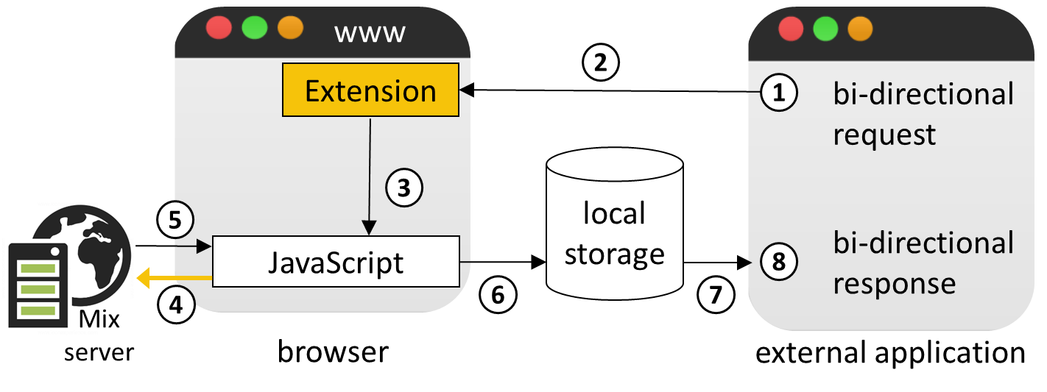
Bi-directional channel: Chat
General purpose bi-directional channel
  Sandboxed iframe
  Same-Origin-Policy
Use case: chat
  End-to-end encryption
Mix
  Chat relay
  Constant time reply
Trust assumption: mix is fully trusted
  PIR, ZKP?
Notes:
Private Information Retrieval and ZKP are inefficient/need several (i.e. more than one) communication rounds.
Igframe: Needed because now we replace data in the JS. This could be detected. -> context of iframe needs to be protected. -> same origin policy

Slide 10
Ethics? Liability?
User get informed about their participation
  Option to opt out
User do not get harmed
  Computational overhead negligible
  Data overhead minimal ( 7.5MB / day )
Advertisement networks / Tracking Services
Ethics committee approval
Notes:
Ethical: We do not harm involuntary users and the data overhead is small. Only for non-mobile users. We inform user on the website and give option to opt out.

Slide 11
What could go wrong?
Protocol transcripts are indistinguishable
  Chat and Feed look identical due to TLS
What else can attacker do?
  Analyze user’s entry server visiting pattern
  Measure execution time by network timestamps
We assume:
  Precise knowledge of execution time distributions for voluntary and involuntary user.
Notes:
Extension and the external application introduces some overhead in the browser execution for the voluntary users.

Slide 12
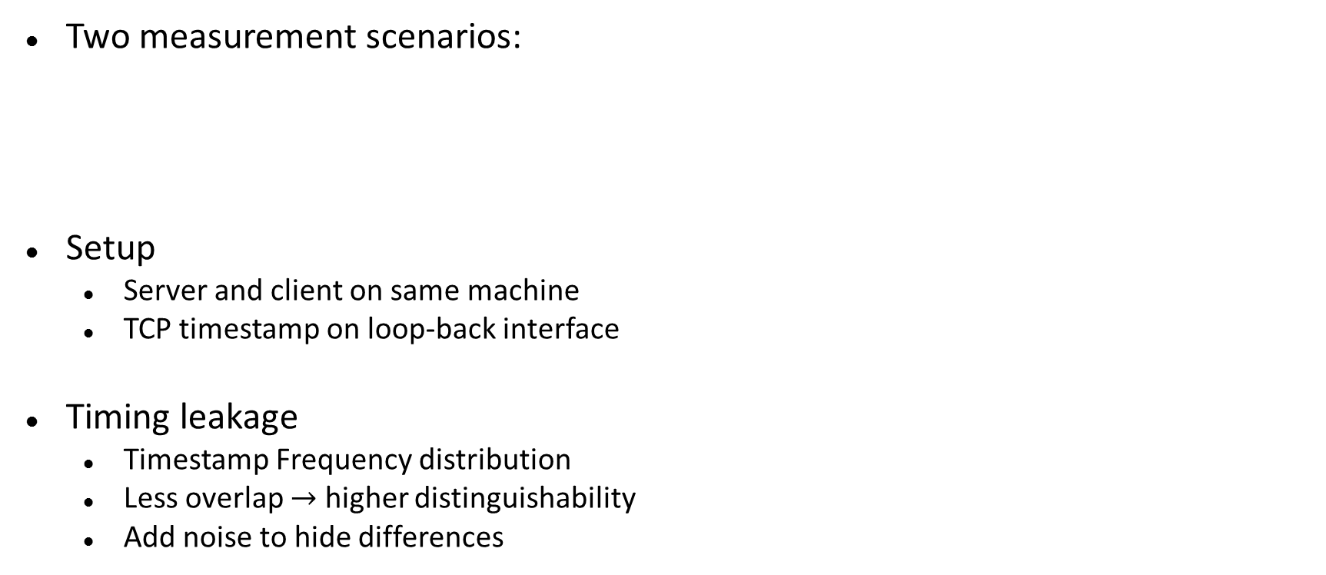
CoverUp: Timing Leakage
In-Execution
Two measurement scenarios:
Setup
  Server and client on same machine
  TCP timestamp on loop-back interface
Timing leakage
  Timestamp Frequency distribution
  Less overlap $→$ higher distinguishability
  Add noise to hide differences
CoverUp JavaScript
In-Exec
In-Exec
Browser
Initialization
time
Mix Server
Initialization
Notes:
Efficiency reason/
Time measurement between concurrent droplets (periodic) or receive JS and sending first request (loading)
Give basic intuition about the overlapping distribution, why the overlap is bad for a distinguisher.

Slide 13
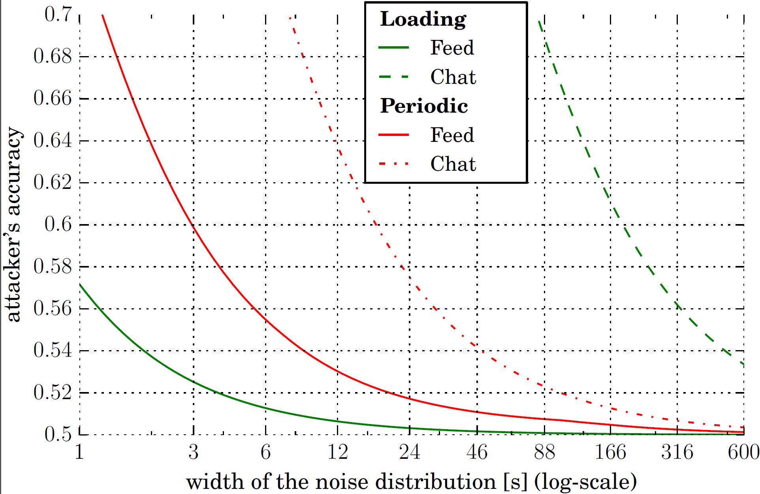

CoverUp: Adding Noise
Add uniform noise $∈ [0, width]$
$accuracy := \frac{tp+tn}{tp+tn+fp+fn}$
              $tp$ = true positive
              $fn$ = false negative
In-Execution
p
p
add
Initialization
noise
0
t
0
w
t
Upper Privacy Bound
Sample size: 1K (Initialization), 10K (In-Execution)
Notes:
Give some intuition why adding noise helps, increases the overlapping portion significantly from the non overlapping part of these 2 distribution.
Now go the graph and first explain what is on x and y axis. Increasing x axis improves privacy but bad for user experience as it increases latency.

Slide 14
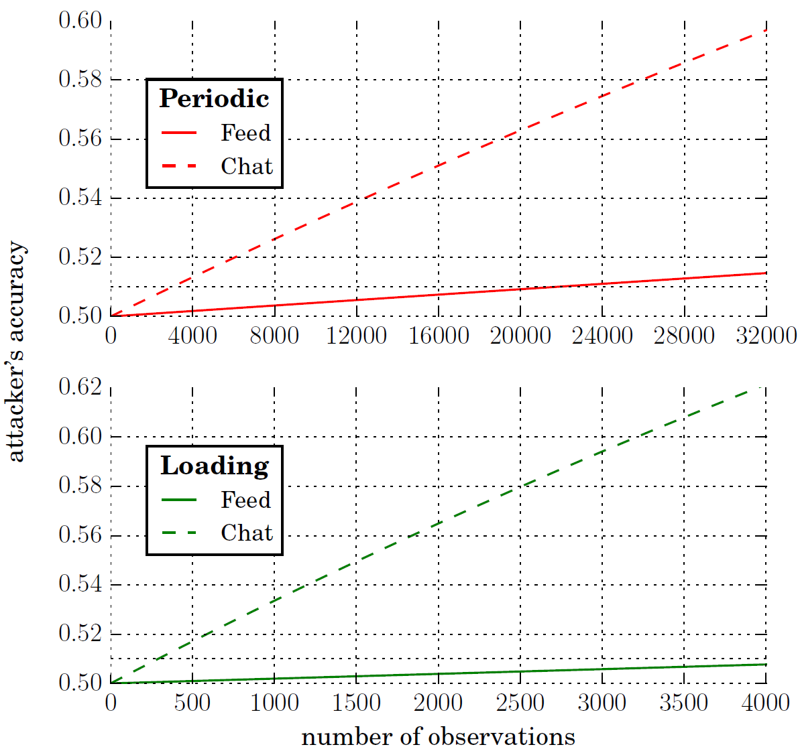
CoverUp: Privacy Budget
Type | Width | ETA
Periodic | 60s | 30s
Loading feed | 40s | 20s
Loading chat | 10min | 5min
In-Execution
Privacy Budget for Feed
  Invoke feed 4 times/day, 10min/stay*
  1k loading & 20k periodic observations/year
  Privacy budget: 1 year @ acc < 51%
Initialization
*Calculated over working days
Notes:
Do not have enabled the extension all the time (switch off button)

Slide 15
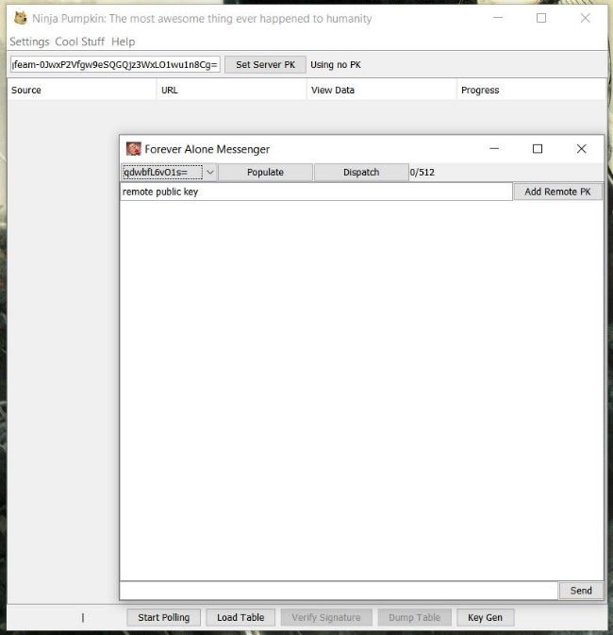
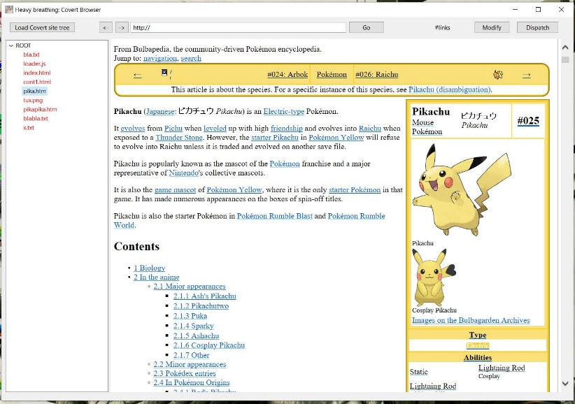
CoverUp: Implementation
External application
  Implemented in Java
  Features: feed, chat and interactive browsing
  Uses crypto APIs from whisper systems and JCA
Browser extension
  Firefox extension based on WebExtension API
Mix and CoverUp server
  Implemented using Java EE Servlet API
  Hosted on Apache Tomcat webserver

Slide 16
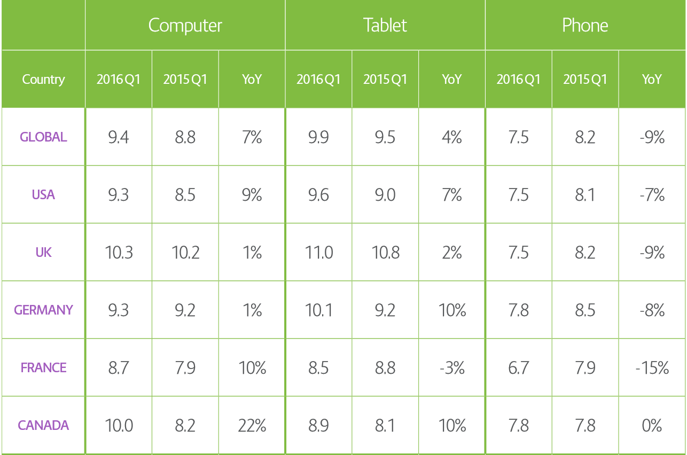
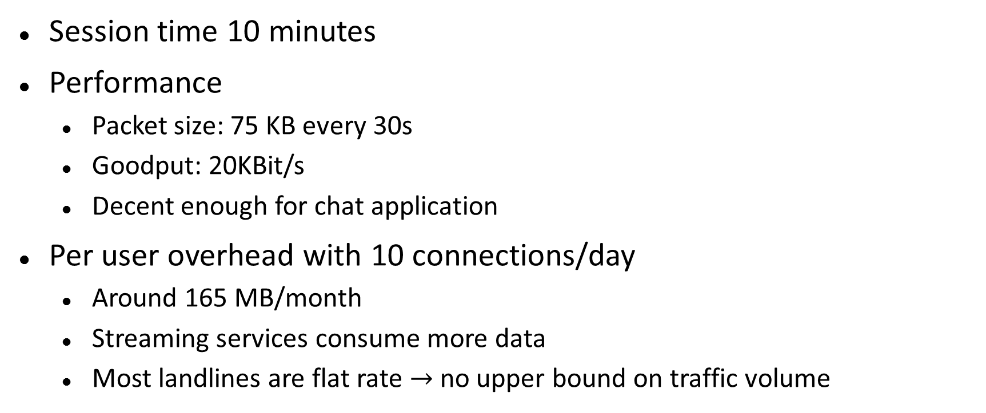
CoverUp: Performance
Session time 10 minutes
Performance
  Packet size: 75 KB every 30s
  Goodput: 20KBit/s
  Decent enough for chat application
Per user overhead with 10 connections/day
  Around 165 MB/month
  Streaming services consume more data
  Most landlines are flat rate $→$ no upper bound on traffic volume
Reference: Demandware shopping index 2016Q1
Notes:
We exclude mobile users. But they will have flat rates in a few years as well.
Session time number might be per site and not per tab reload. But there we could use a “global shared worker” to let the tabs communicate.

Slide 17
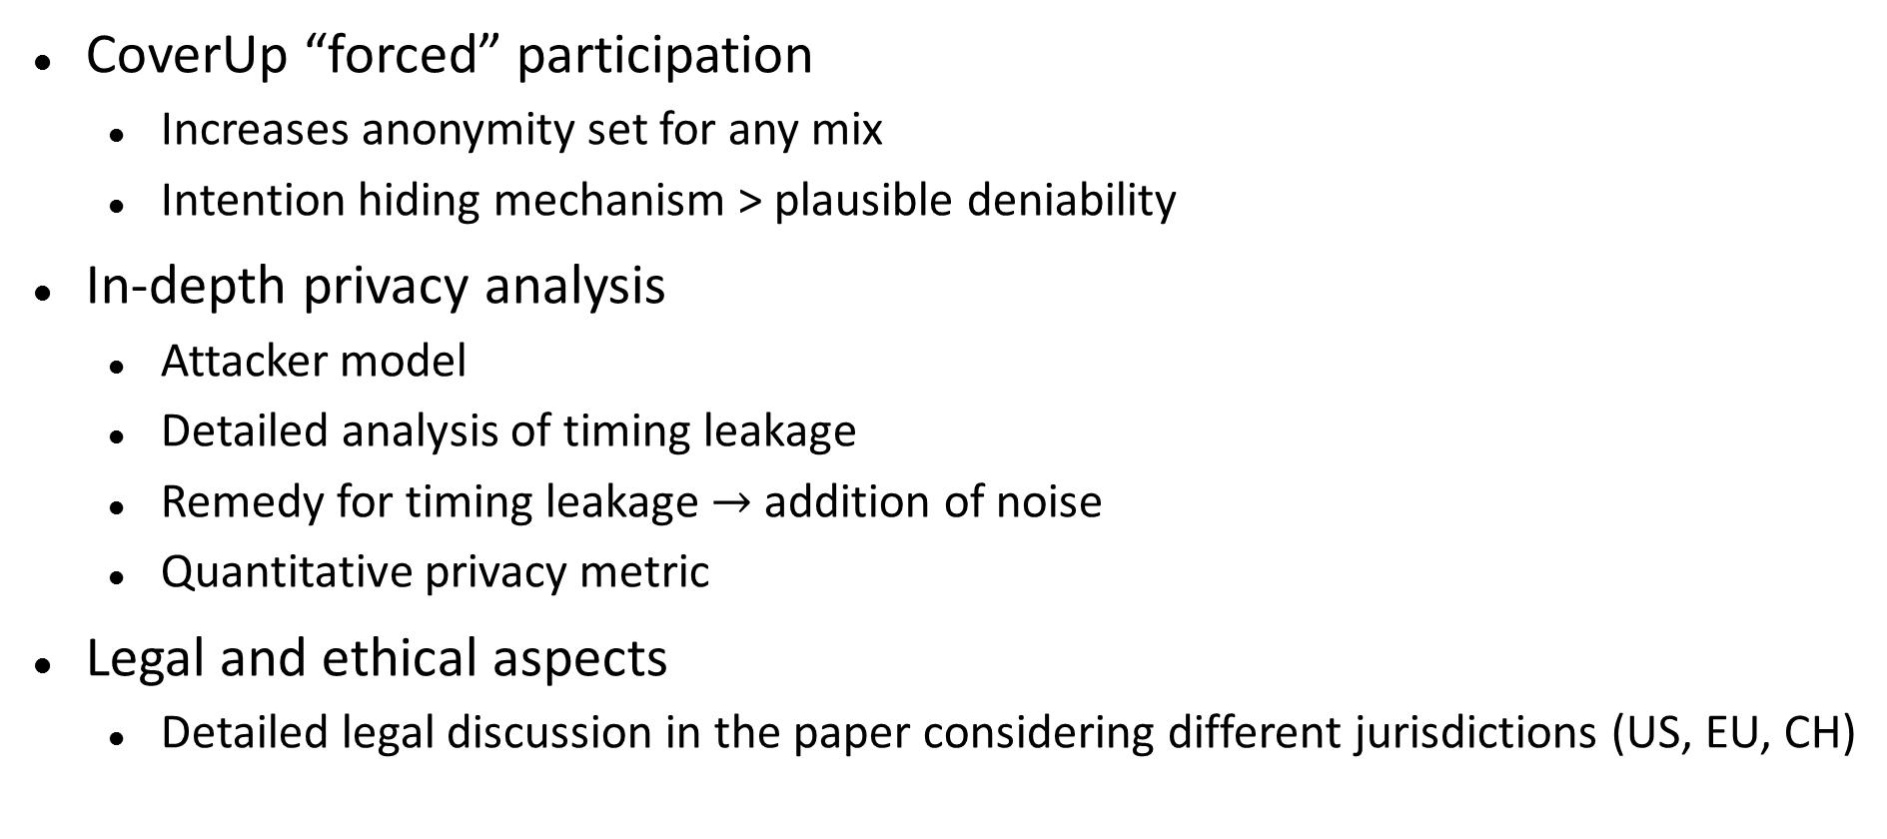
Conclusions
CoverUp “forced” participation
  Increases anonymity set for any mix
  Intention hiding mechanism > plausible deniability
In-depth privacy analysis
  Attacker model
  Detailed analysis of timing leakage
  Remedy for timing leakage $→$ addition of noise
  Quantitative privacy metric
Legal and ethical aspects
  Detailed legal discussion in the paper considering different jurisdictions (US, EU, CH)

Slide 18

Thank you

Slide 19
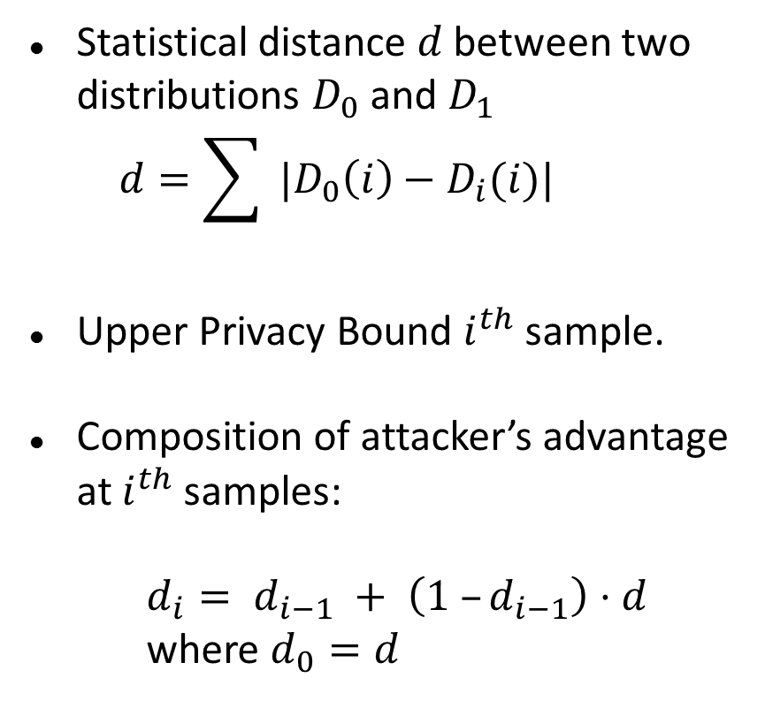
CoverUp: Upper Privacy Bound
Statistical distance $d$ between two distributions $D_{0}$ and $D_{1}$
  $$d=\sum{{ |D}_{0}\left(i\right)−D_{i}(i)|}$$
Upper Privacy Bound $i^{th}$ sample.
Composition of attacker’s advantage at $i^{th}$ samples:
  $d_{i}= d_{i−1} + \left(1 –d_{i−1}\right)⋅d$
  where $d_{0}=d$

Slide 20
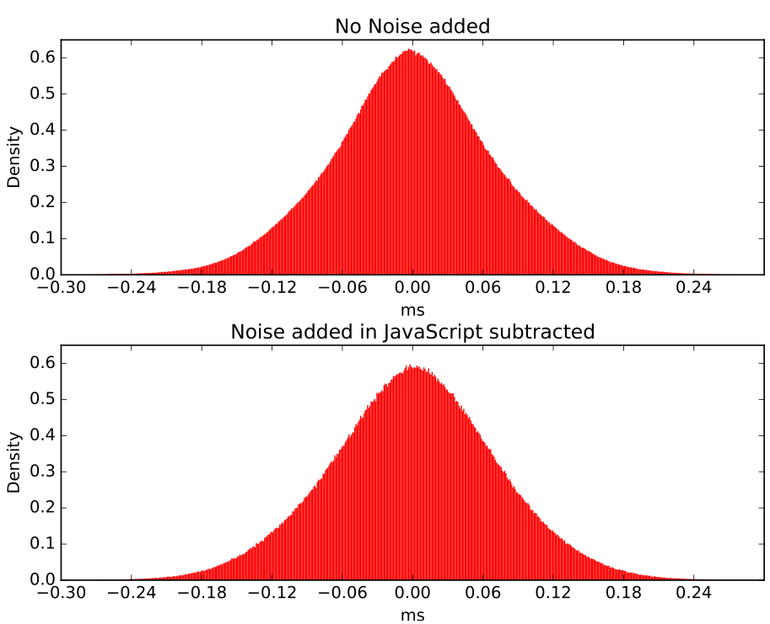
Independence of additional noise
Overlap: 98.2%

