Slide 1
CoverUp: Upload and Download via Passive Participation
David Sommer, Aritra Dhar, Luka Malisa
Esfandiar Mohammadi, Srdjan Čapkun, Daniel Ronzani

Slide 2
Were you Ever Afraid to …
whistleblowers
… download something that is easily accessible?
Maybe someone is watching?
free speech
↯
mass surveillance
accessing primary sources (e.g., WikiLeaks)
(essential for an informed democracy)
Notes:
David: Where you ever afraid..
Aritra: Thez alredy got me.. (showing arm)
David: No, seriously, this is important for Whistleblowers, free speech, or accessing primary sources.
Aritra: But ISP and Government might analyze your traffic.

Slide 3
Motivation: Deniability and Participation
ACN - Strong anonymity
Hide which users are connected to whom
Limits surveillance and censorship
Participation alone raises suspicion
Little deniability
Bootstrapping Problem
Unattractive latency and/or bandwidth
Low number of connected users
unattractive degree
of anonymity
small anonymity set
Notes:
Aritra: But there are ACNs.. E.g, TOR, freenet. . They hide in different ways the link between sender and receiver. And they may limit surveillance and censorship.
David: That’s right but there are two fundamental problems.
Participation. Bootstrapping problem: vicious cycle.
Aritra This is a realz hard problem to solve.
Establishment of communication $−>$ Intention of communication

Slide 4
Our contribution: Passive Participation
Web site visitors passively produce cover traffic
❶
❶
❷
❸
❷
❶
User visits reddit
Reddit responds
and includes a piece
of JavaScript code
This JS code produces
cover traffic
❸
passive
cover traffic
passive
cover traffic
participant
❷
participant
❸
real traffic
active
Notes:
Aritra: How about our contribution: Passive Participation? (Explain idea, in short)

Slide 5
Our contribution: Passive Participation
Web site visitors passively produce cover traffic
Indistinguishability
Larger anonymity set
Anonymity set size = active + passive
Mitigates bootstrapping
Provides deniability
❶
❸
❷
passive
cover traffic
passive
cover traffic
participant
≈
❶
❸
❷
real traffic
active
participant
Notes:
Aritra: How about our contribution: Passive Participation? (Explain idea, in short)

Slide 6
CoverUp: Contributions
Uses Passive Participation
Uni-directional channel: Feed
Bi-directional channel: Transfer
Working Prototype
Analyzed Network Timing leakage
Notes:
Aritra: Coincidentially, we used passive participation in a tool named CoverUp. Unidirectional *Radio Broadcast, where you cannot influence, what you receive) and bi-directional that allows you to arbitrarily do up/ and download.
Aritra: … working prototype, for network-attacker protocol wise indistinguishable. But timing leakage.

Slide 7
CoverUp: Feed
active participants
passive participants
(1) connects to
browser
JS code in sandboxed iframe due to Same-Origin-Policy
Attacker controls:
Network (monitor/drop/fake)
Entry Server (reddit)
CoverUp server (delivers js code)
Feed Server (delivers feed)
Active user’s machine not compromised
(5) extract feed
feed
feed
(2) triggers clients
to connect to
.
.
.
CoverUp Tool
browser
CoverUp server
(5) extract feed
feed
(3) connects clients via JS to
feed
CoverUp Tool
(4) sends messages to
Feed Server
Notes:
David: Explains Feed.. We can tolerate a verz strong attacker. Mention why users machine must not be compromised.
Ethics: Opt-in
Mention: unidirectional case! Iframe. Javascript. Cache
Mention indistinguishability. Because all do the same.
We want Privacy and Anonymity, not Integrity. (else signature key)
Feed consists out of more than one packet. How does this work?

Slide 8
CoverUp: Feed
active participants
passive participants
(1) connects to
browser
(5) extract feed
feed
feed
Indistinguishability
Active and passive participants: same protocol
Difference: CoverUp Tool
Provides Deniability
(2) triggers clients
to connect to
.
.
.
CoverUp Tool
browser
CoverUp server
(5) extract feed
feed
(3) connects clients via JS to
feed
CoverUp Tool
(4) sends messages to
Feed Server
Notes:
David: Explains Feed.. We can tolerate a verz strong attacker. Mention why users machine must not be compromised.
Ethics: Opt-in
Mention: unidirectional case! Iframe. Javascript. Cache
Mention indistinguishability. Because all do the same.
We want Privacy and Anonymity, not Integrity. (else signature key)
Feed consists out of more than one packet. How does this work?

Slide 9
Protecting Passive Participants
Fountain Codes
+ All-or-Nothing Scheme
active participant
passive participant
reddit
+
+
local
storage
=
JavaScript
Feed Server
Browser
Only one packet stored
→ protects passive participants
CoverUp Tool
Notes:
Aritra:
Predefined list of documents -> random delivery -> no choice (would reveal intention)
Error correction code: order does not matter, one collects these pieces until one has enough to assemble end data
All or nothing encryption scheme: Set to protect people, no dangerous content on passive users machines

Slide 10
CoverUp: Transfer
Bi-directional channel
Adds upstream channel
Involves extension
Using TLS
Indistinguishability
Trust Transfer Server
Trust CoverUp Server
Augments Feed
Active participant
www
2
Extension
1
request
local
storage
3
5
JavaScript
8
response
4
6
7
Transfer Server
browser
CoverUp Tool
Notes:
David: Extend feed bz piggy pack payloads. still passive users
Trust transfer AND denpending on the setup coverup server.
STILL USES INVOLUNTARY USERS!!
CoverUp Server trsted.. Additional slide?
Feed Server handles now bi-directional connections. Restrictions, predictable traffic patterns, treats dummy and real traffic indistinguishable (constant time), not reveal anything.
"for the attacker all traffic looks indistinguishable"
Why? The traffic pattern could reveal information.
Sends custom data to mix.
We do not replace the request in the extension, too much timing leakage.
Extension and JS already loaded
HTTPS
Augments feed, may be independent

Slide 11
Evaluating the Indistinguishability Assertion
Protocol transcripts are indistinguishable
Everything else identical?
But active users have CoverUp tool and browser extension (in Transfer)
What can network attacker do?
Measure execution time by network timestamps
Timing leakage
Evaluation
Mitigation
Notes:
Extension and the external application introduces some overhead in the browser execution for the voluntary users.
NOTE: Limit obserservation of the attacker to only timing leakage (protocol wise indistinguishable, TLS, )

Slide 12
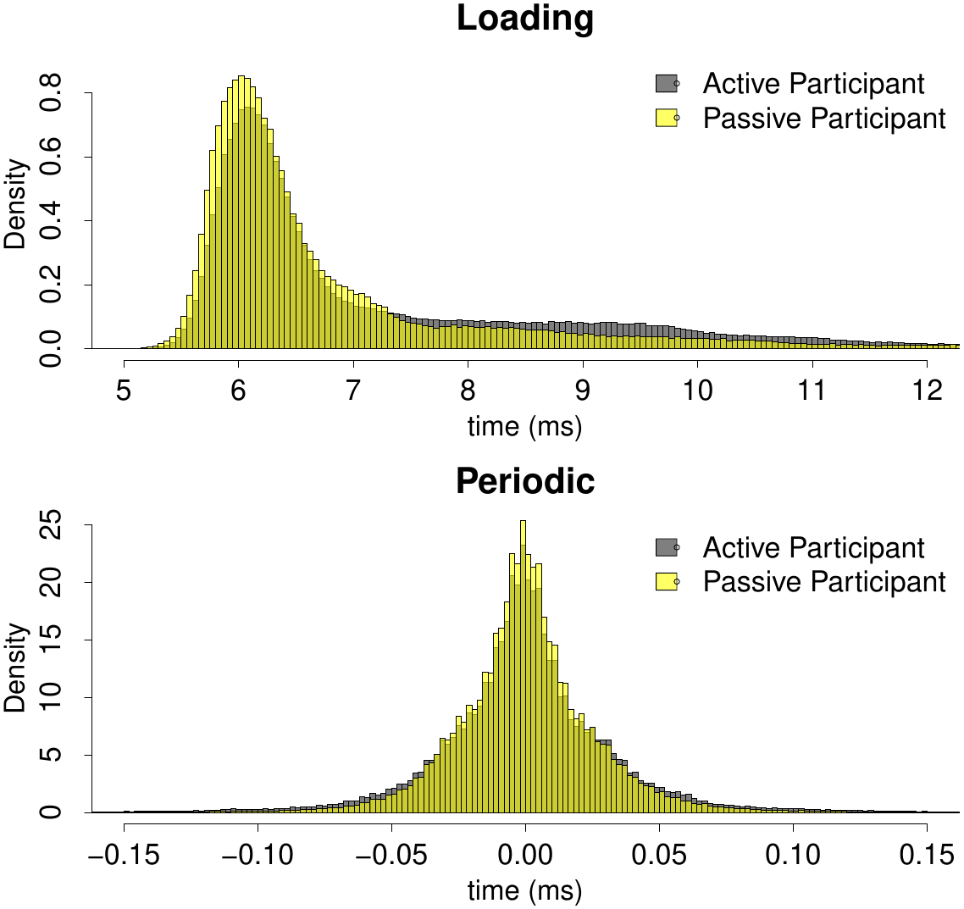
CoverUp: Experimental Setup
Setup: LAN, entry, transfer, and feed server
Feed and Transfer scenarios:
Strong attacker model:
No other processes running on the system
High-precision time resolution
3 Million measurements
CoverUp JavaScript
Periodic
Periodic
Browser
time
Loading
Transfer Server
Notes:
We assume that in-exection and initialization are not correlated.
We measured TCP accuracy timestamp (TCP option 8) of 0.4ms on windows.
Linear increase of accuracy
Efficiency reason/
Time measurement between concurrent droplets (periodic) or receive JS and sending first request (loading)
Give basic intuition about the overlapping distribution, why the overlap is bad for a distinguisher.

Slide 13
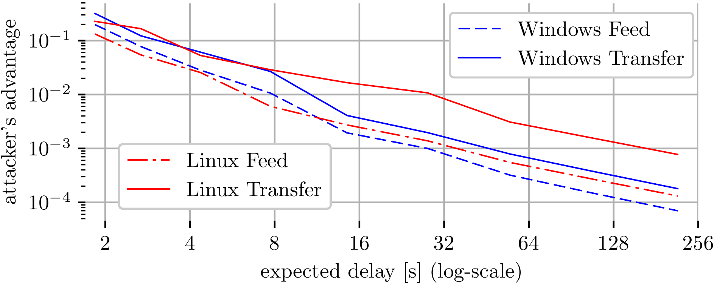
CoverUp: Privacy Budget
Request dispatch time: add truncated Gaussian noise
Continual observation for half a year
< 5 hours of visiting the entry server
(Periodic-observations) per day
< 50 connecting to the entry server
(Loading-observations) per day
p
p
p
*
0
t
0
w
t
0
w
t
Notes:
Expected delay is result of added noise. Accuracy: how often you made the correct prediction.
Arm joke here.,,,,,
Linux Transfer outlier caused by experimental problems.
Active user is always active. This is worst case.

Slide 14
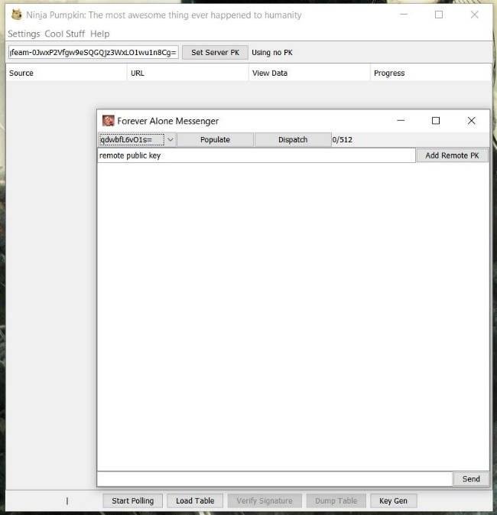
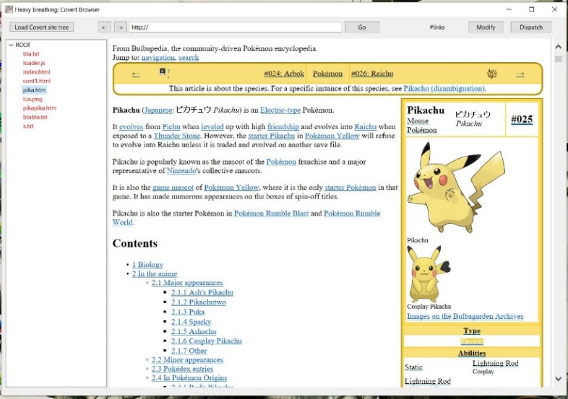
CoverUp: Implementation
CoverUp Tool
Implemented in Java
Features: feed, chat and interactive browsing
Uses crypto APIs from whisper systems and JCA
Browser extension
Chrome extension based on WebExtension API
Feed/Transfer and CoverUp server
Implemented using Java EE Servlet API
Hosted on Apache Tomcat webserver
Available for download and testing: http://coverup.ethz.ch

Slide 15
CoverUp: Performance
Performance
Packet size: 75KB every 60s avg.
Goodput: 10KBit/s
Per user overhead
Around 660 MB/month or 22MB/day
Privacy guarantee
Attacker’s advantage < 2${∙10}^{−3}$
cnn.com: 4.0MB
amazon.com: 5.0MB
alibaba.com: 5.4MB
Notes:
We exclude mobile users. But they will have flat rates in a few years as well.
Session time number might be per site and not per tab reload. But there we could use a “global shared worker” to let the tabs communicate.

Slide 16
CoverUp: Summary
browser
(5) extract feed
feed
Passive Participation
Increases anonymity set (Bootstrapping)
Hides Intention (Deniability)
Adding Noise reduces Timing Leakage
Maintains feasible usability
Measurements available
(2) triggers clients
to connect to
CoverUp Tool
CoverUp server
(3) connects clients via JS to
(4) sends messages to
Available for testing: https://coverup.ethz.ch
Available for download: https://github.com/sommerda/CoverUp-source-code
Feed Server

Slide 17
Thank you

Slide 18
Backup Slides

Slide 19
Feature Work: Extending Transfer Server to ACN
Transfer Server --> ACN
Must not reveal dummies
Predictable traffic pattern
Point-to-point communication
Helps bootstraping ACNs
Improves deniability

Slide 20
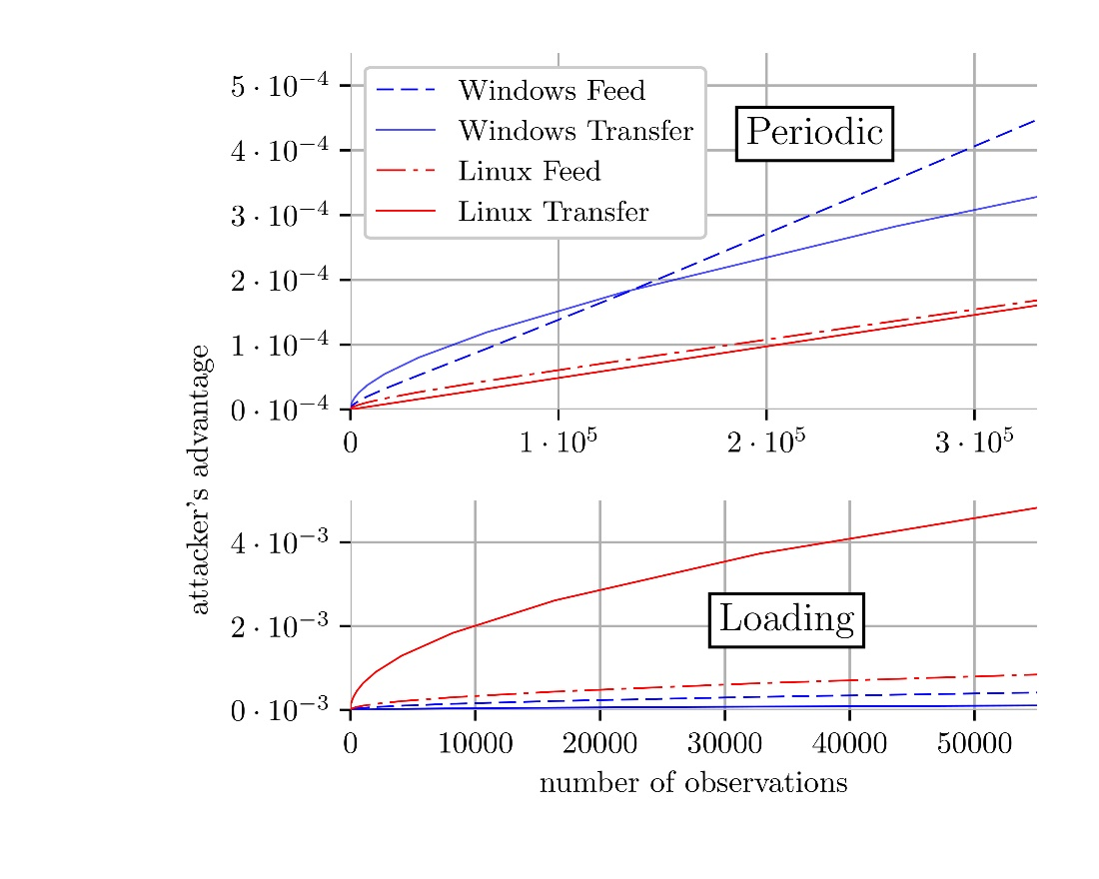
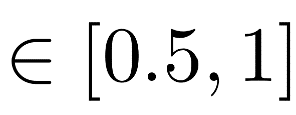
CoverUp: Adding Noise
Add uniform noise $∈ [0, width]$
$accuracy := \frac{tp+tn}{tp+tn+fp+fn}$
$tp$ = true positive
$fn$ = false negative
p
p
add
noise
0
t
0
w
t
with 5s of expected delay
Notes:
Expected delay is result of added noise. Accuracy: how often you made the correct prediction.

Slide 21
CoverUp: Imperfect User Behaviour
Protocol transcripts are indistinguishable
Analyze user’s entry server visiting pattern
Altered behavior leaks privacy
CoverUp, to the rescue!
Notes:
Imperfect: If voluntary participant diverges from behaviour of involuntary ones.

Slide 22
CoverUp: Ethics?
User could get informed about their participation
Option to opt out / opt it in a browser / on a page
Users do not get harmed
Computational overhead negligible
Data overhead minimal ( 7.5MB / day )
Advertisement networks / Tracking Services already execute code and ‘store’ data (temporarily) in browser cache
Blockchain Mining? (e.g. Monero)
Notes:
Ethical: We do not harm involuntary users and the data overhead is small. Only for non-mobile users. We inform user on the website and give option to opt out.

Slide 23
Legal (Convention on Cybercrime (CCC))?
Illegal access (article 2 CCC) penalizes the entering of a computer system. However, download of the JavaScript from the CoverUp server is standard browser functionality for communication. The same would happen if the entry server were financed by online advertising.
Data interference (article 4 CCC) penalizes the damaging, deletion, deterioration, alteration or suppression of computer data “without right”. CoverUp does not damage, delete, deteriorate, or suppress data on the participant’s client. However, it does alter the data on the hard disk: on the one hand the webpage with the iframe uses disk space and thus modifies the participant’s data. However the explanatory report to the Convention on Cybercrime foresees that the file causing data interference be “malicious”. Code is malicious if it executes harmful functions or if the functions are undesirable.
Notes:
Ethical: We do not harm involuntary users and the data overhead is small. Only for non-mobile users. We inform user on the website and give option to opt out.

Slide 24
Legal (Convention on Cybercrime (CCC))?
Misuse of devices (article 6 CCC) penalizes the production, making available, or distribution of a code designed or adapted primarily for the purpose of committing a cybercrime offense, or the possession of such a computer program. One of the main questions relating to the misuse of devices is how to handle dual use devices (code). Dual use means in our case that the JavaScript code could be used to download legal content, e.g. political information, as well as illegal content, e.g. child pornography. CoverUp was not produced for offensive purposes and makes sure that content is only available to voluntary users.
Notes:
Ethical: We do not harm involuntary users and the data overhead is small. Only for non-mobile users. We inform user on the website and give option to opt out.

Slide 25
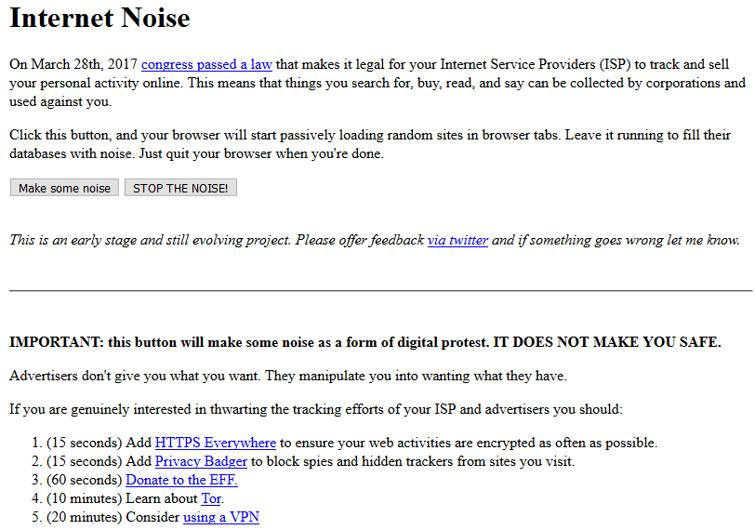
CoverUp: Limiting Profiling by ISPs
https://slifty.github.io/internet_noise/index.html
Notes:
So.. There is a tool doing this.

